Slide 1
Exploration of parallel implementation of Machine Learning algorithms for shared memory architecture
By, Team #1
Siddhant Kulkarni
Ritesh Sangurmath

Slide 2
Content
Prologue
Machine Learning
Definition
Applications
Categorization
Supervised Machine Learning
Naïve Bayesian Classifier
Example
Issues
Target Application

Slide 3
C
Content
UNSUPERVISED LEARNING
EXAMPLES
APPLICATION
TYPES
CLUSTERING
Applications
Types
Partitional Clustering
K-MEANS ALGORITHM
EXAMPLE
TARGET APPLICATION

Slide 4

Prologue
Researchers everywhere:

Slide 5
Prologue
Faster calculations
Apple iPhone 6 ~ Supercomputer in 1999
Faster I/O
SSDs
Faster analysis of large scale data
Distributed systems EVERYWHERE!

Slide 6

Prologue
Goal of this project:
Explore why and how we should or should not make use of parallel data processing for one of the most famous applications of data analytics
MACHINE LEARNING

Slide 7
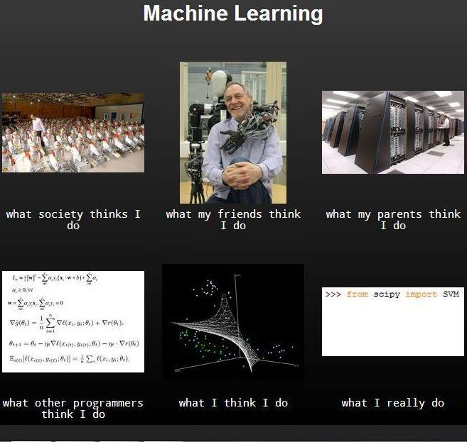

Slide 8
What is machine learning?
Get Data
Learn
Apply Knowledge

Slide 9
What is machine learning?
Sounds simple right?
Some of it is as simple as that…
Rest of it…. NOT SO MUCH!

Slide 10

Where does machine learning fit into our world?

Slide 11
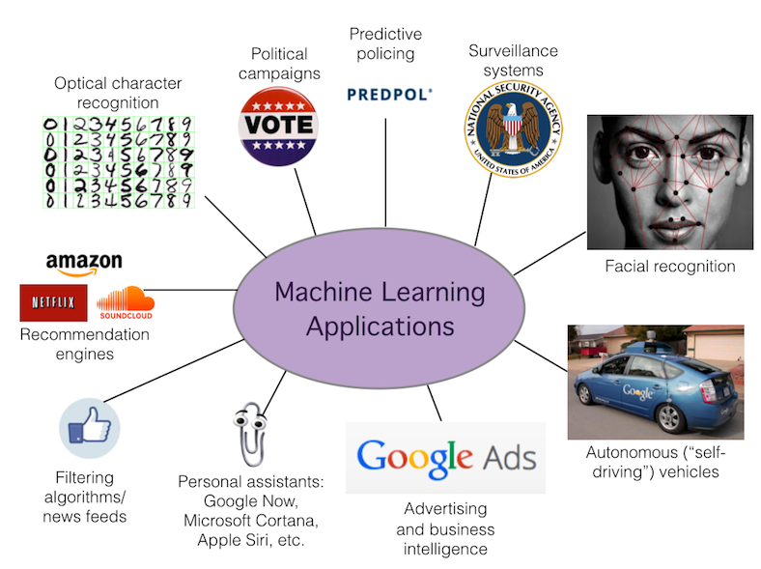
What are some applications of Machine Learning?

Slide 12


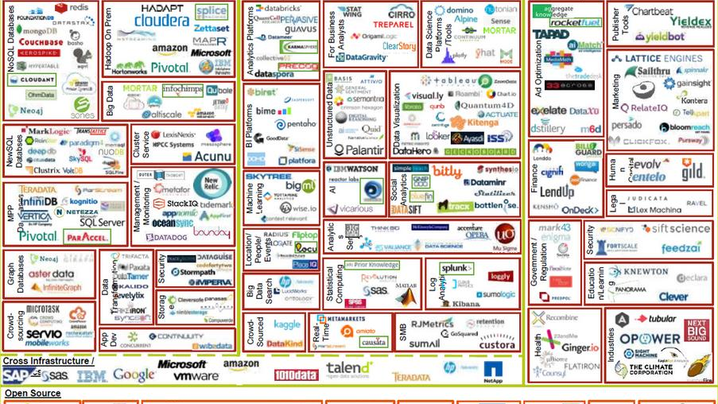
How is machine learning dealing with large volume and velocity of data?

Slide 13
Why use parallel programming?
There are several machine learning applications that require near-real time responses
For example,
Security systems that are based on Machine Learning
Web based searches (Not as critically damaging, but has business impact)
What is out there right now for processing of large scale streams?
SPARK!

Slide 14
Why shared memory instead of distributed?

Slide 15
Machine learning
Supervised
Unsupervised
Categories of Machine Learning

Slide 16
Supervised Machine learning
Available data is labelled
Example: WEATHER HISTORY
Popular techniques
Classification
Regression

Slide 17

Supervised Machine learning
Notes:
Example, weather prediction v stock market prediction
District v continuous

Slide 18

Supervised learning - Classification

Slide 19
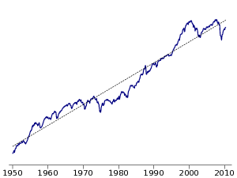
Supervised learning - Regression

Slide 20
For this project we will be focusing on the classification problem

Slide 21
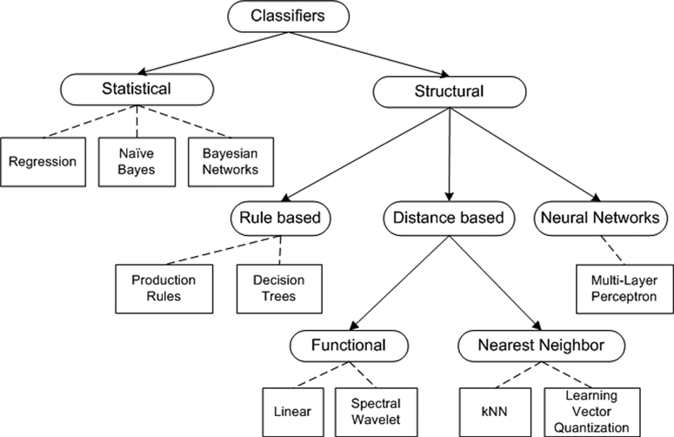
Classification Algorithms

Slide 22
Since we cannot do everything, we will focus on the Naïve Bayesian classifier!

Slide 23

Naïve Bayesian Classifier
Based on the Bayes Theorem
$$P\left(A | B\right)=\frac{P\left(B | A\right)P(A)}{P(B)}$$
Probability of A happening when B happens is equal to the ratio of the probability of B happening when A happens multiplied by probability of A happening to probability of B happening.

Slide 24
Naïve Bayesian Classifier
Simply put,
It calculates probability of an attribute having a particular value with the value to be predicted
For example,
Given certain Humidity
Will it rain today?

Slide 25
Naïve Bayesian Classifier
Naïve Bayesian assumes conditional independence
This means that it assumes all the features that we are looking at are independent
For example, it will not account for interdependence between humidity and temperature while predicting whether or not it will rain
THUS THE NAME!!

Slide 26


Slide 27
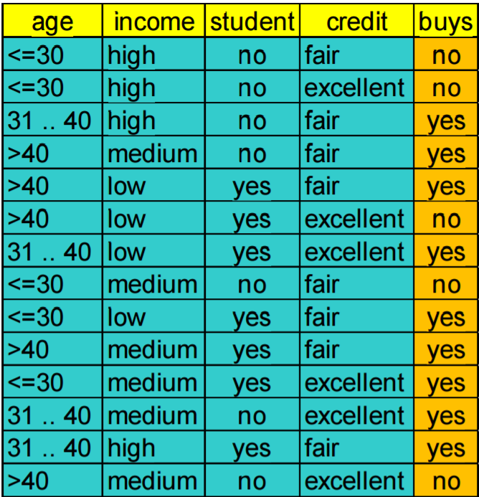
Naïve Bayesian Example of Learning Phase
Notes:
Consider this data for a bit…

Slide 28
Naïve Bayesian Example of Learning Phase
Age | Buys | Count
<=30 | No | 1
Income | Buys | Count
High | No | 1
Stud | Buys | Count
No | No | 1
Credit | Buys | Count
Fair | No | 1
Buys | Buys | Count
No | No | 1

Slide 29
Naïve Bayesian Example of Learning Phase
Age | Buys | Count
<=30 | No | 2
Income | Buys | Count
High | No | 2
Stud | Buys | Count
No | No | 2
Credit | Buys | Count
Fair | No | 1
Excellent | No | 1
Buys | Buys | Count
No | No | 2

Slide 30
Naïve Bayesian Example of Learning Phase
Age | Buys | Count
<=30 | No | 2
31-40 | Yes | 1
Income | Buys | Count
High | No | 2
High | Yes | 1
Stud | Buys | Count
No | No | 2
No | Yes | 1
Credit | Buys | Count
Fair | No | 1
Excellent | No | 1
Fair | Yes | 1
Buys | Buys | Count
No | No | 2
Yes | Yes | 1

Slide 31
Naïve Bayesian Example of Learning Phase

Slide 32
Naïve Bayesian Example of Learning Phase Frequency counts
Age | Buys | Count
<=30 | No | 3
31-40 | No | 0
>40 | No | 2
<=30 | Yes | 2
31-40 | Yes | 4
>40 | Yes | 3
Income | Buys | Count
High | No | 2
Medium | No | 2
Low | No | 1
High | Yes | 2
Medium | Yes | 4
Low | Yes | 3
Stud | Buys | Count
No | No | 4
Yes | No | 1
No | Yes | 3
Yes | Yes | 6
Credit | Buys | Count
Fair | No | 2
Excellent | No | 3
Fair | Yes | 6
Excellent | Yes | 3
Buys | Buys | Count
No | No | 5
Yes | Yes | 9

Slide 33
Naïve Bayesian Example of Learning Phase Probabilities
Age | Buys | P(B|A)
<=30 | No | 0.6
31-40 | No | 0
>40 | No | 0.4
<=30 | Yes | 0.22
31-40 | Yes | 0.44
>40 | Yes | 0.33
Income | Buys | P(B|A)
High | No | 0.4
Medium | No | 0.4
Low | No | 0.2
High | Yes | 0.22
Medium | Yes | 0.44
Low | Yes | 0.33
Stud | Buys | P(B|A)
No | No | 0.8
Yes | No | 0.2
No | Yes | 0.33
Yes | Yes | 0.67
Credit | Buys | P(B|A)
Fair | No | 0.4
Excellent | No | 0.6
Fair | Yes | 0.67
Excellent | Yes | 0.33
Buys | Buys | P(B)
No | No | 0.36
Yes | Yes | 0.64

Slide 34

Now that we have those calculated…

Slide 35
Naïve Bayesian Example of testing Phase
Assume we get the following customer in store:
X =
Class | <=30 | Medium | Yes | Fair | Class [ P(B) ]
Yes | 0.22 | 0.44 | 0.67 | 0.67 | 0.64
No | 0.6 | 0.4 | 0.2 | 0.4 | 0.36

Slide 36
Naïve Bayesian Example of testing Phase
Assume we get the following customer in store:
P(X | ” yes ”) = 0.22*0.44*0.67*0.67*0.64 = 0.028
P(X | ” no ”) = 0.6*0.4*0.2*0.4*0.36 = 0.007
So, P(X | ” yes ”) > P(X | ” no ”)
We predict that this customer WILL buy
X =

Slide 37
Problems with the naïve assumption?
Some things are dependent on each other…

Slide 38

Like these two depend on each other to stay “Trending”

Slide 39
Problems with the naïve assumption?
Something happens that no one expected…

Slide 40


Slide 41
Problems with the naïve assumption?
We might think something won’t matter but it ultimately does!

Slide 42
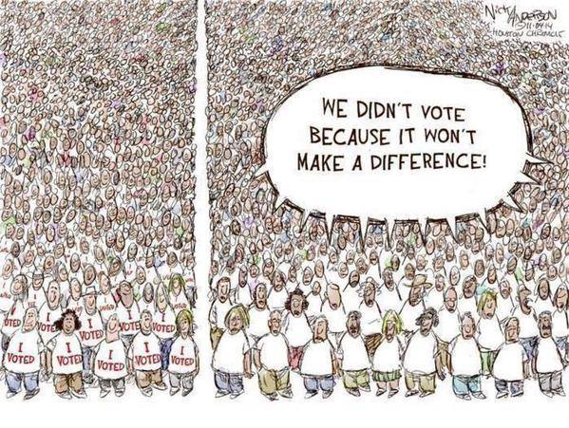

Slide 43
Will we focus on solutions for these issues?

Slide 44


Slide 45
… we won’t.

Slide 46
For this project, we will try to implement a serial and a MIMD/SPMD version of the naïve Bayesian classifier

Slide 47
Why naïve Bayesian?

Slide 48
Target application
Signature based Intrusion Detection System for detection of DoS and DDoS attacks
The data will be in the form of network logs
Dataset provided by the KDD ‘99 [1] machine learning competition

Slide 49


Slide 50

UNSUPERVISED LEARNING

Slide 51
UNSUPERVISED LEARNING
Unsupervised learning is where we have the input data(x), we don’t have the corresponding output variables.
All the data in the unsupervised is unlabeled or with the same label.
Since the data given are unlabeled, there is no error or reward signal to evaluate a potential solution

Slide 52
UNSUPERVISED LEARNING
Unlike the Supervised learning in the Unsupervised learning we don’t have the correct answer or the fixed output.
The goal for unsupervised learning is to model the underlying structure or distribution in the data in order to learn more about the data.

Slide 53
Examples Of Unsupervised Learning

Slide 54
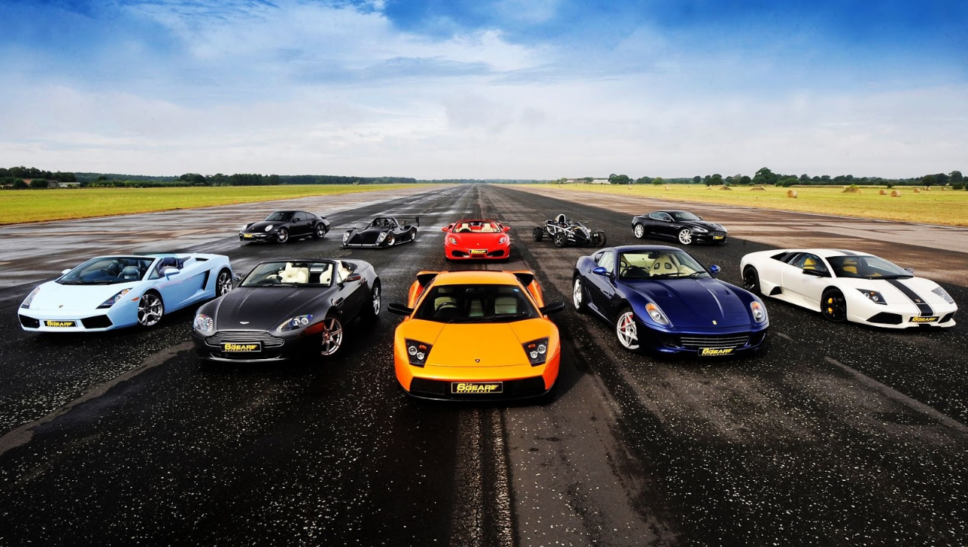
1. Group of Unlabeled Cars

Slide 55
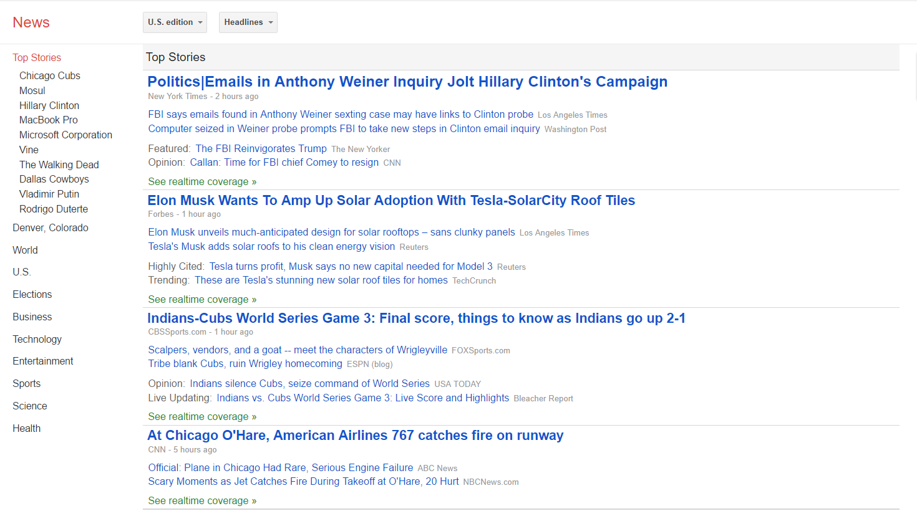
2. NEWS.GOOGLE.COM

Slide 56
APPLICATIONS OF THE UNSUPERVISED LEARNING
Dependency Parser
Morphology
Sentence Segmentation
Machine Translation

Slide 57
TYPES OF UNSUPERVISED LEARNING
Unsupervised learning algorithm problem can be further classified into two problems:
CLUSTERING: A clustering problem is where you want to discover the inherent groupings in the data, such as grouping customers by purchasing behavior.
ASSOCIATION: An association rule learning problem is where you want to discover rules that describe large portions of your data, such as people that buy X also tend to buy Y.

Slide 58
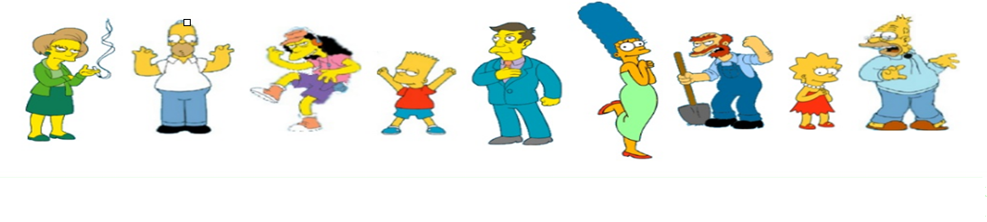
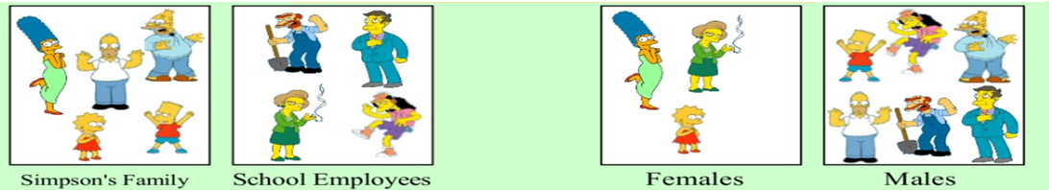
CLUSTERING

Slide 59
CLUSTERING
Clustering is the process of dividing the large dataset into the groups such that:
The member of each group share the similar features and are close as possible to one another.
And the different group are as far as possible from one another

Slide 60
Examples Of CLUSTERING

Slide 61
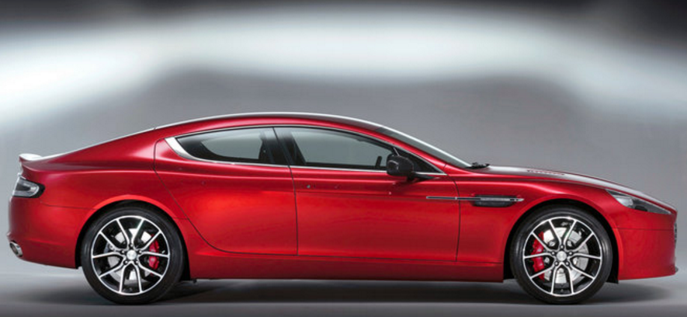
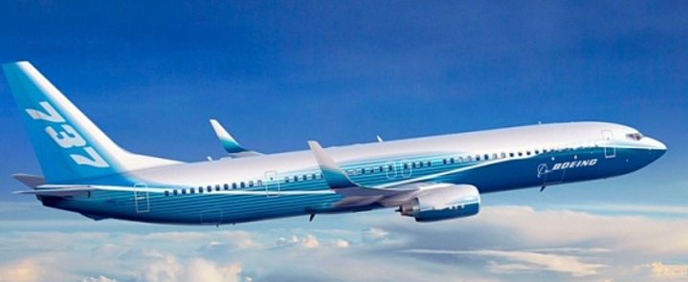
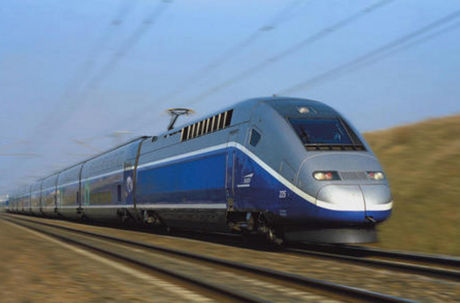

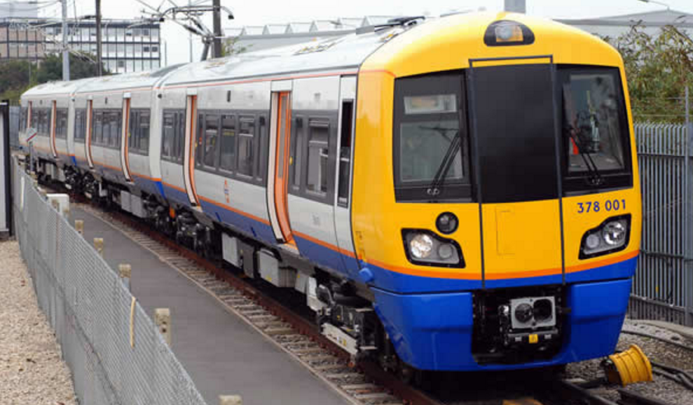
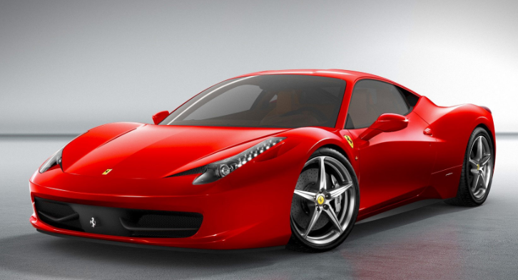
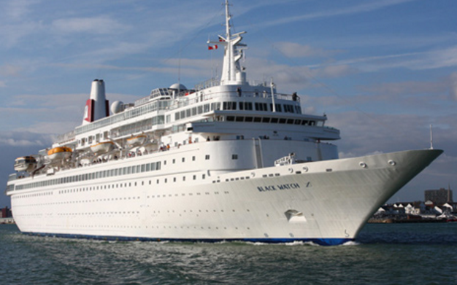
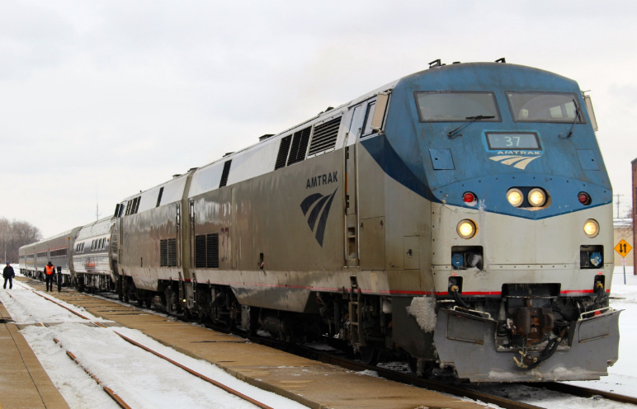


Slide 63
OTHER EXAMPLES OF CLUSTERING
Search Engine
Marketing
Social Networking analysis

Slide 64
APPLICATION OF CLUSTERING
Text Mining
Pattern Recognition
Wireless Sensor Network
Search Engine

Slide 65
TYPES OF CLUSTERING
CLUSTERING
HIERARCHICAL
PARTITIONAL

Slide 66
HIERARCHICAL CLUSTERING
Hierarchical clustering involves creating the cluster that have a predetermined ordering from top to bottom.
In hierarchical clustering, the two most similar clusters are combined and continue to combine until all objects are in the same cluster.
Hierarchical clustering produces a tree (called a dendogram) that shows the hierarchy of the clusters.

Slide 67
TRANSPORTATION
LAND TRANSPORTATION
AIR TRANSPORTATION
WATER TRANSPORTATION
TRAIN
CARS
DOMESTIC
AIRLINES
INTERNATIONAL
AIRLINES

Slide 68
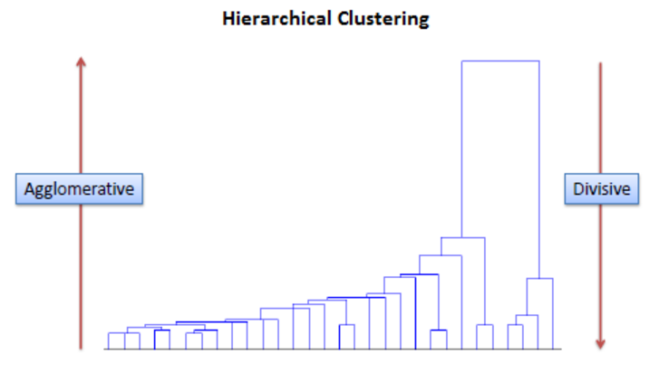
TYPES OF HIERARCHICAL CLUSTERING
Agglomerative :In this method we assign each observation to its own cluster. Then, compute the similarity between each of the clusters and join the two most similar clusters. Finally, repeat these steps until there is only a single cluster left.
Divisive: In this method we assign all of the observations to a single cluster and then partition the cluster to two least similar clusters. Finally, we proceed recursively on each cluster until there is one cluster for each observation.

Slide 69
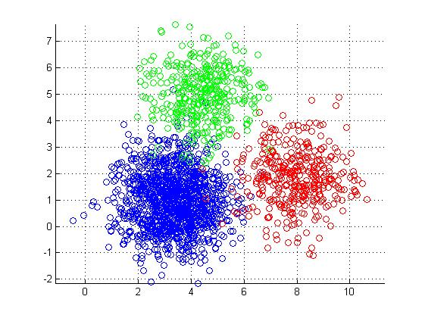
PARTITIONAL CLUSTERING
Partitional clustering results in N set of clusters, each object belong to a cluster.
Each cluster will be having a centroid or a cluster representative, this is some sort of the summary description of the complete object in the cluster.

Slide 70
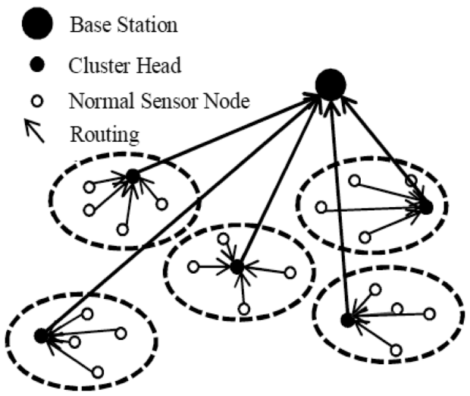
EXAMPLES OF PARTITIONAL CLUSTERING
Wireless Sensor Networks

Slide 71
TYPES OF PARTITIONAL CLUSTERING
K-MEANS CLUSTERING: K-Means clustering intends to partition n objects into k clusters in which each object belongs to the cluster with the nearest mean. This method produces exactly k different clusters of greatest possible distinction.
SELF-ORAGANIZING MAP: SOM provide a way of representing multidimensional data in much lower dimensional spaces - usually one or two dimensions. This process, of reducing the dimensionality of vectors, is essentially a data compression technique known as vector quantization.

Slide 72
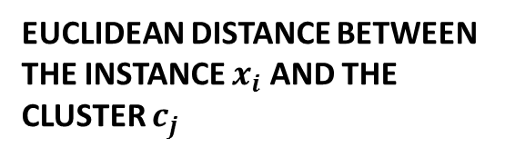
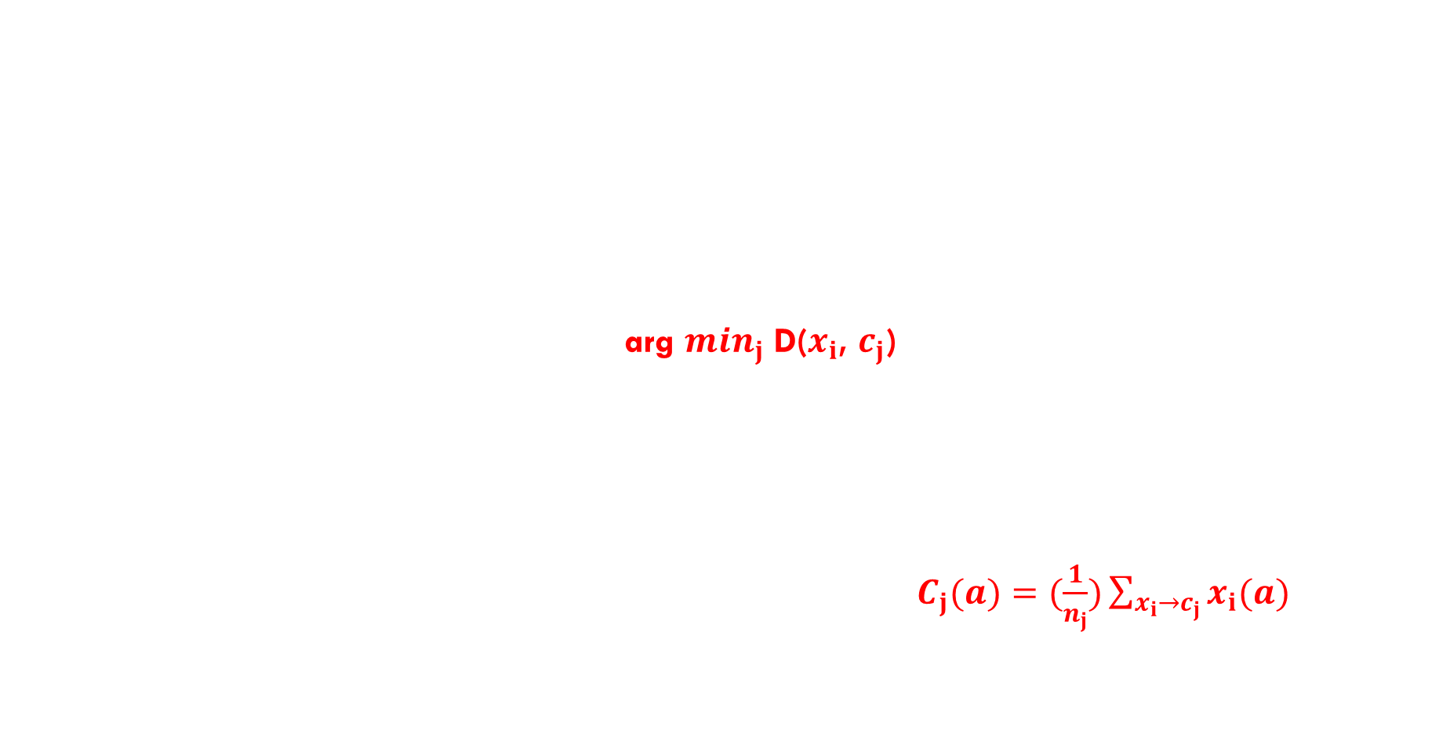
K-MEANS CLUSTERING ALGORITHM
Input: K – Number of cluster,
set of points {$x_{1}$ ……….. $x_{n}$}
Place the K number of centroid { $C_{1}$…………….. $C_{K}$} in the random location.
Repeat until convergence:
Step 1 (for each point $x_{i}):$
- Find the nearest Centroid $C_{j}$ arg $\min_{j}$ D($x_{i}$, $c_{j}$)
- assign the point $x_{i}$ to the cluster j
Step 2 ( for each cluster j= 1…….K}
- Calculate the new centroid location by computing the mean of all
the $x_{i}$ point assigned to each cluster j in the Step 1. $C_{j}(a)$ $=(\frac{1}{n_{j}})\sum_{{x_{i}→c}_{j}}{x_{i}(a)}$
Repeat the above steps until the centroid relocation does not changes.
EUCLIDEAN DISTANCE BETWEEN THE INSTANCE $x_{i}$AND THE CLUSTER $c_{j}$

Slide 73
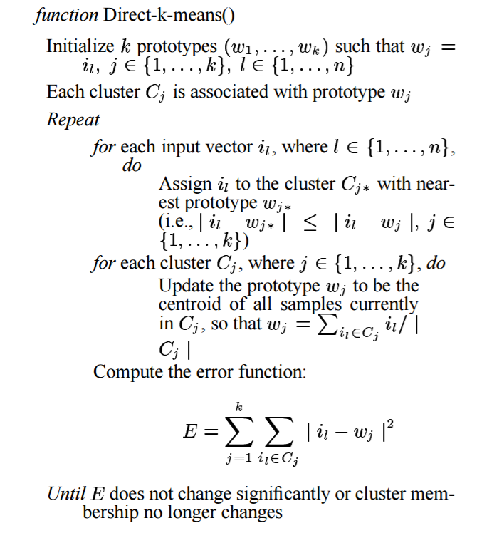
K-MEANS CLUSTERING ALGORITHM

Slide 74
K-MEANS CLUSTERING EXAMPLE

Slide 75
TARGET APPLICATION
Applying the k-means clustering on the image retrieval is a daunting task as there will large number data that has to be clustered.
So it might be beneficial to parallelize the k-means which might reduce the amount of time required in retrieving the data for image retrival.
All the data are in number arranged in the form of vector.

Slide 76
Project objective
Our objective is to
Understand the use and implementation of two algorithms
Classification – Naïve Bayesian
Clustering – K-means
Implement two versions of the aforementioned algorithms
Serial Implementation – C++
Parallel Implementation – C++, OpenMP
Evaluate the performance of the implementations and identify ways to improve them

Slide 77
Conclusion
Machine learning is everywhere
Everyone is trying to deal with large volume and velocity of data
We intend to target the later for two algorithms
Naïve Bayesian
K-means
We intend to make use of C++ and OpenMP

Slide 78
References:
Tapas Kanungo, David M. Mount, Nathan S. Netanyahu, Christine D. Piatko, Ruth Silverman, and Angela Y. Wu. 2002. An Efficient k-Means Clustering Algorithm: Analysis and Implementation. IEEE Trans. Pattern Anal. Mach. Intell. 24, 7 (July 2002), 881-892.
V. D. Katkar and S. V. Kulkarni, "Experiments on detection of Denial of Service attacks using Naive Bayesian classifier," Green Computing, Communication and Conservation of Energy (ICGCE), 2013 International Conference on, Chennai, 2013, pp. 725-730.
https://www.cs.utexas.edu/~kuipers/readings/Alsabti-hpdm-98.pdf
http://machinelearningmastery.com/supervised-and-unsupervised-machine-learning-algorithms/
https://en.wikipedia.org/wiki/Unsupervised_learning
https://www.quora.com/What-is-the-difference-between-supervised-and-unsupervised-learning-algorithms
http://www.met.edu/Institutes/ICS/NCNHIT/papers/39.pdf
http://www.saedsayad.com/clustering_hierarchical.htm
http://www.ai-junkie.com/ann/som/som1.html

Slide 79


Slide 80


